Slide 1
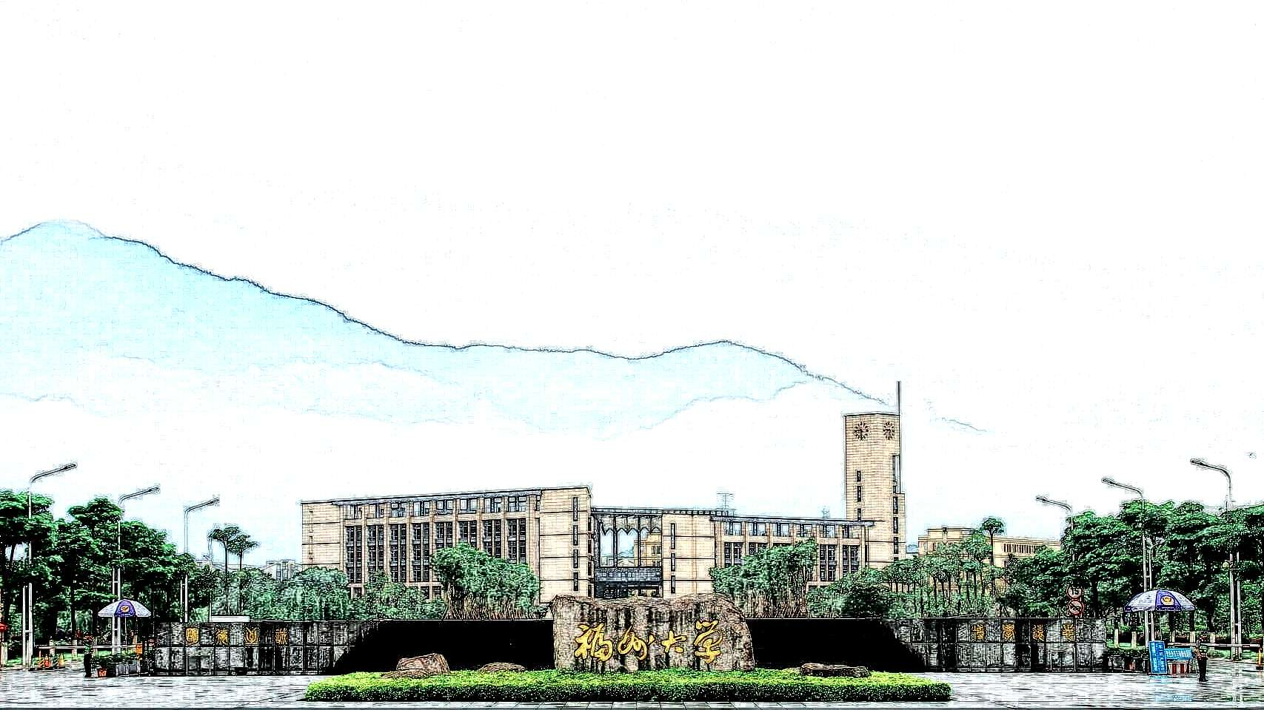


AAAI 2024: 利用基于学习的技术保护十亿蓝牙设备
—— 如何把本科毕设发表到权威会议？
蔡汉霖 832002117
Notes:
Hi, this is the interim video presentation of Hanlin Cai. My research topic is Hybrid Detection Mechanism for Spoofing Attacks in Bluetooth Low Energy Networks.

Slide 2
汇报目的
工作介绍：Securing Billion Bluetooth Devices Leveraging Learning-Based Techniques (AAAI 2024, review in KDD 2024)
知识点讲解：蓝牙网络，时间序列分析，时序卷积网络 TCN
经验分享：如何把本科毕设发表到领域权威期刊 / 会议？
Notes:
As the most widely used low-power communication protocol, cybersecurity research on Bluetooth Low Energy (BLE) has gained great attention. However, due to the security limitations, spoofing attacks can easily compromise BLE devices.

Slide 3
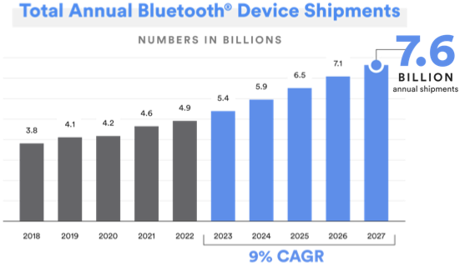
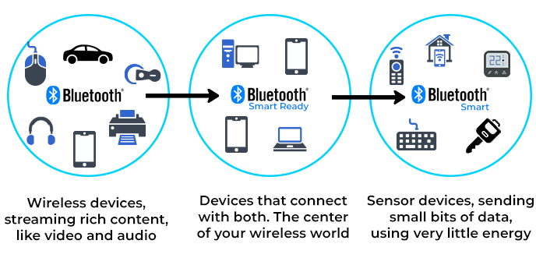
Research Background
Bluetooth Low Energy (BLE) is one of the most widely used wireless protocols. It is expected that the number of BLE devices will reach 7.6 billion by 2027. BLE devices are ubiquitous!
低功耗蓝牙设备几乎无处不在：教育、医疗、工业、生活中的诸多场景
Notes:
As the most widely used low-power communication protocol, cybersecurity research on Bluetooth Low Energy (BLE) has gained great attention. However, due to the security limitations, spoofing attacks can easily compromise BLE devices.

Slide 4
Research Background
BLE Spoofing attack: Feed malicious data to the user devices (manager) 欺骗攻击频发
Due to BLE‘s inherent security limitations and firmware vulnerabilities, spoofing attacks can easily compromise BLE networks and tamper with privacy data^{[1]}. 蓝牙设备普遍缺乏验证机制
并且，超过60%的蓝牙设备不支持固件升级，无法防御新型攻击。亟需开箱即用的防御模式
Notes:
As the most widely used low-power communication protocol, cybersecurity research on Bluetooth Low Energy (BLE) has gained great attention. However, due to the security limitations, spoofing attacks can easily compromise BLE devices.

Slide 5
Research Objective
Our Goals
A physical Bluetooth Low Energy network testbed will be built for attack simulations.
Detection algorithm will be designed to recognize spoofing attacks.
Experiments will be conducted based on real-world advertising datasets.
Overall, this FYP aims to address a crucial challenge in Bluetooth security and provides a substantial dataset for wireless security research.
环境搭建—— 算法研究 —— 实验测试 —— 性能验证 —— 实际应用
Notes:
So, as for the objective of our research. Firstly. Secondly. Also. Overall, this project aims to.
Now, let’s talk about our progress to date and some problems we faced.

Slide 6
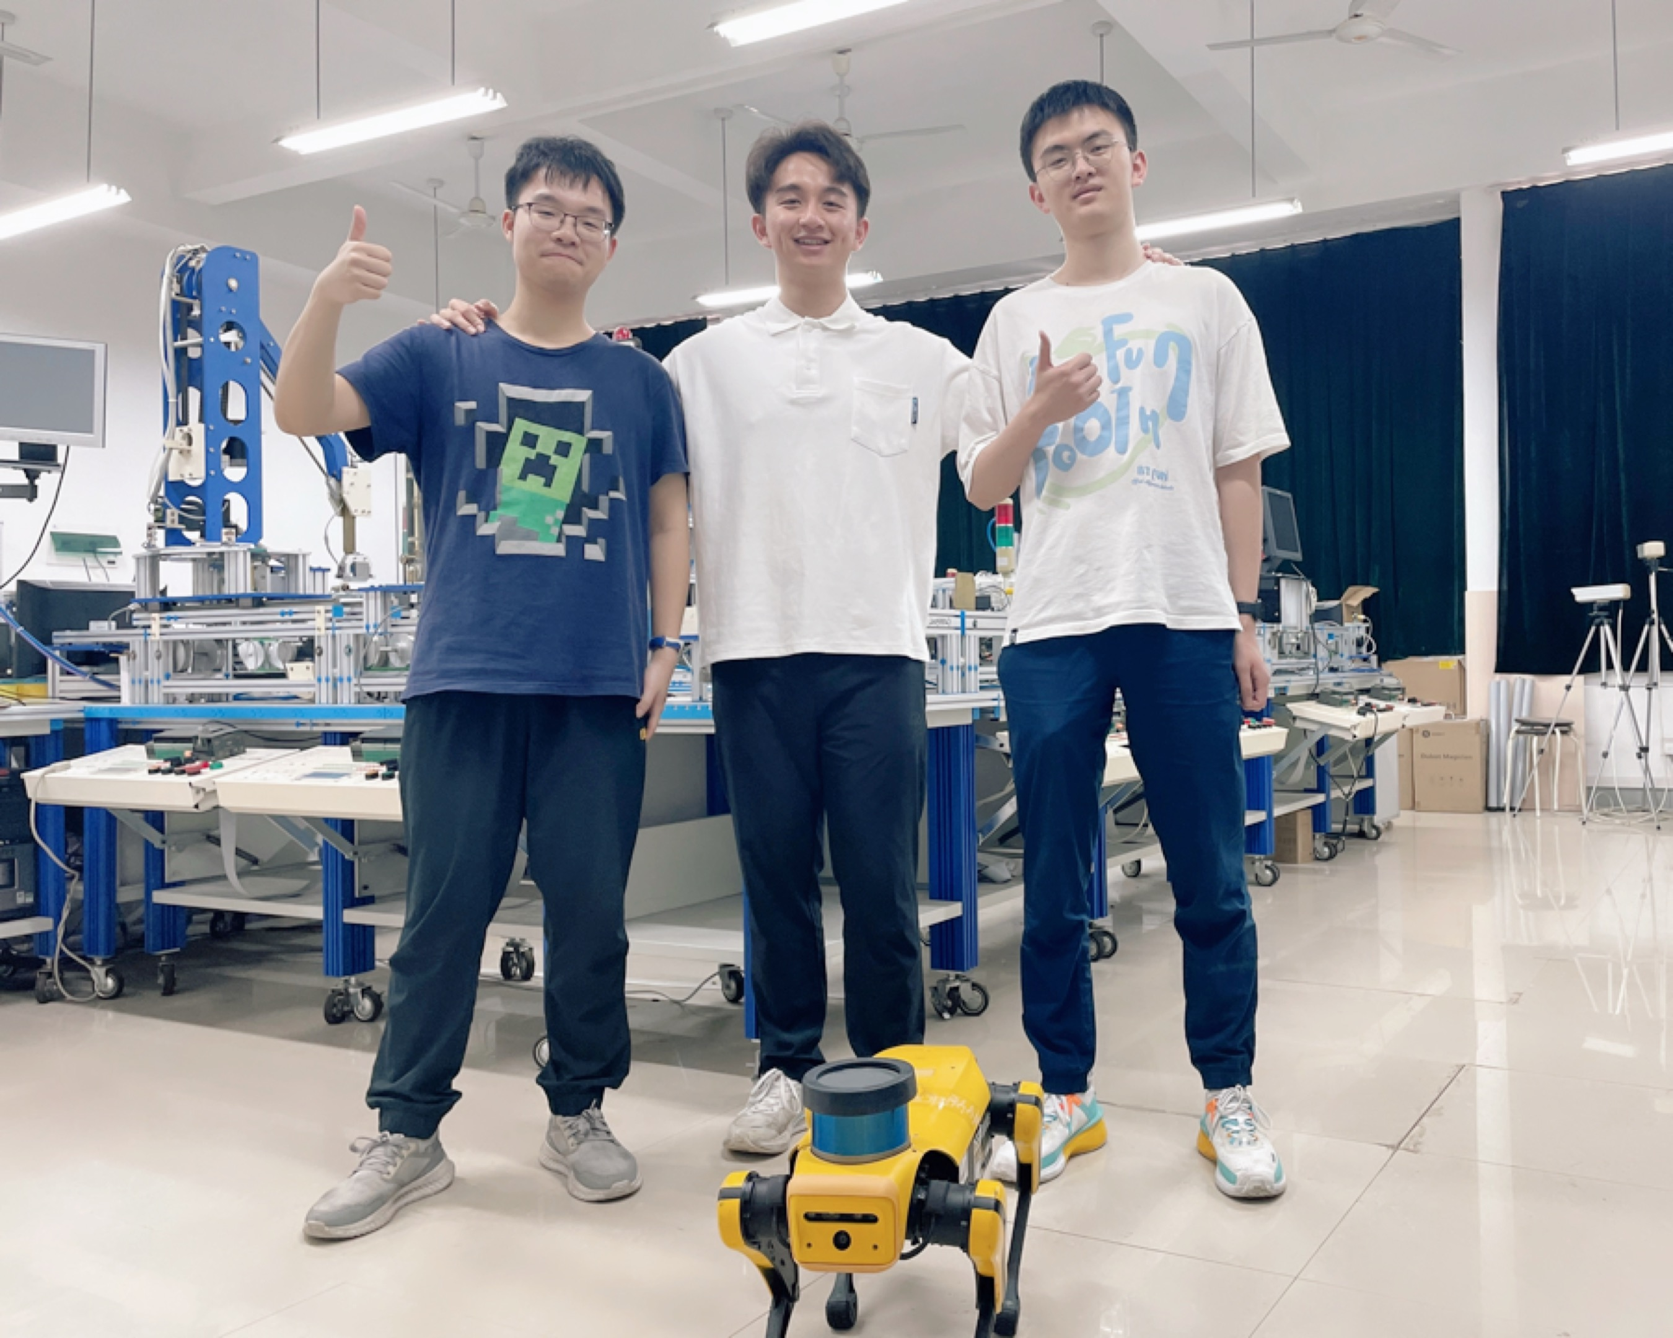
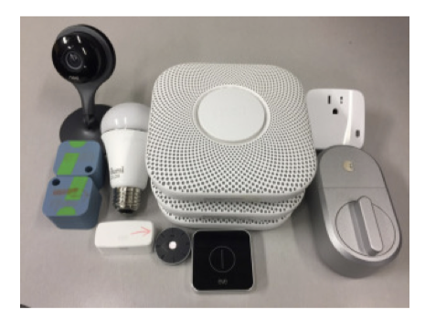
Testbed Implementation
Experimental Lab
Selected BLE Devices
16 Types
Notes:
Currently, we have built a physical BLE testbed in a typically indoor office. As shown in the figure, we have deployed sixteen different BLE devices covering a variety of Bluetooth Chips.

Slide 7
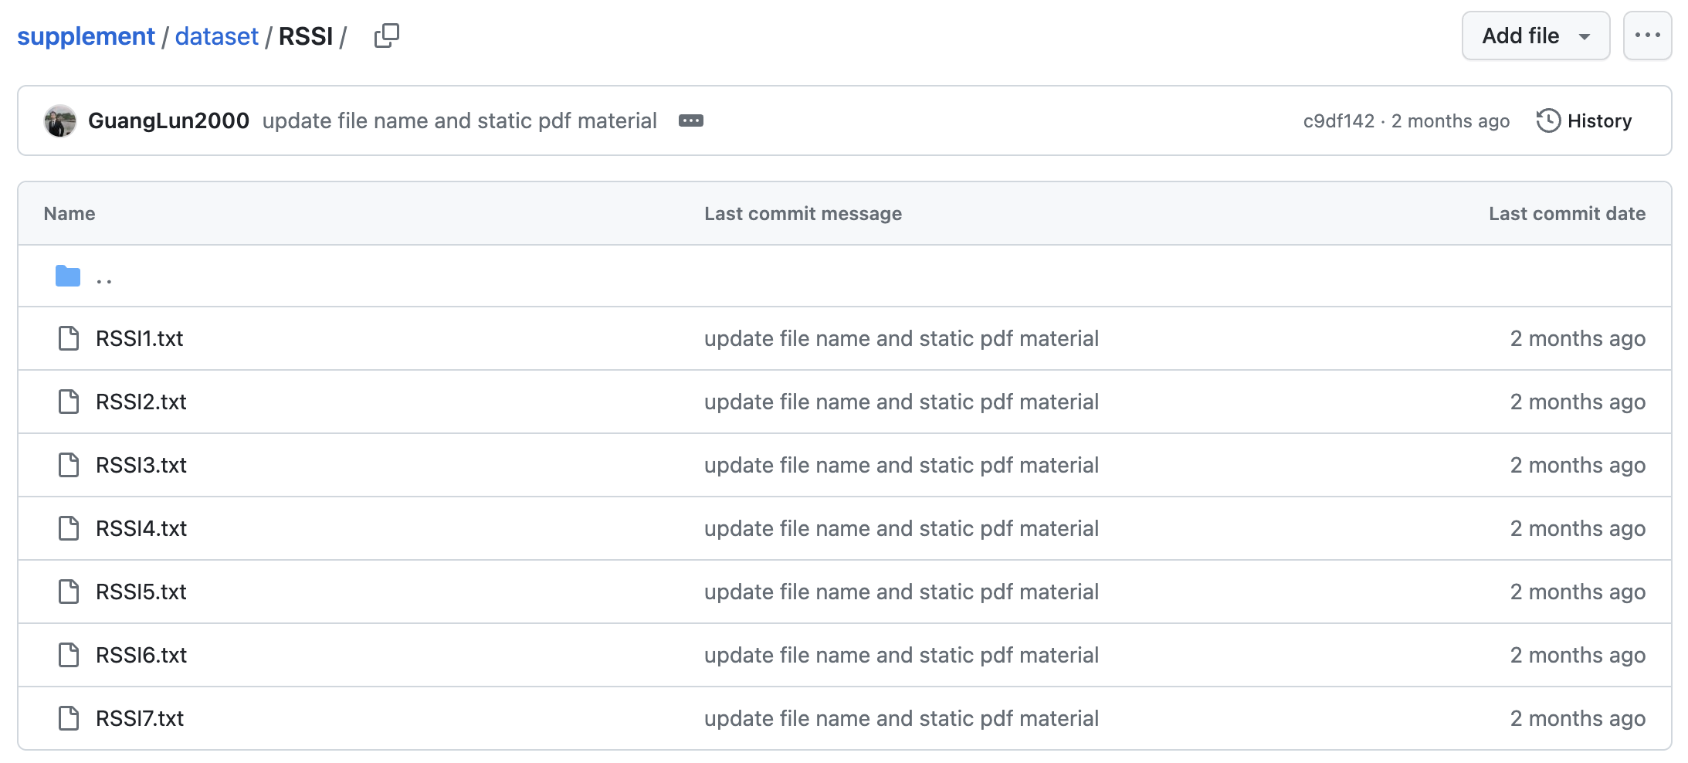
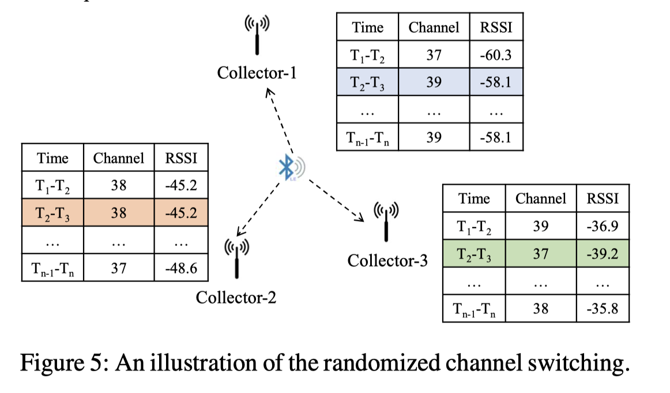
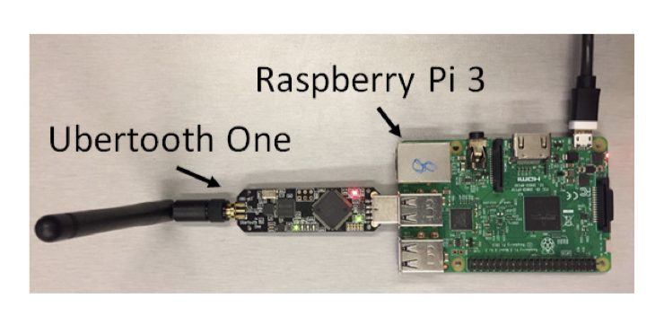
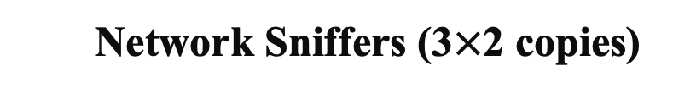
Data Collections
GitHub
BLE Datasets Collecting
Network Sniffers (3$×$2 copies)
Three Sniffer for each group
Notes:
In our testbed, six network sniffers were implemented to capture the network packets. Up to now, we have collected a large-scale network dataset for cyber-physical analysis and model training.

Slide 8
Cyber-physical Analysis
In the spoofing attack scenario, the cyber-physical features of BLE network will undergo noticeable affected, resulting in significant deviations from the benign scenario. 可以采用信息物理特征分析
Notes:
In this stage, to solve the noise interference problem, we used gaussian filter to pre-process the data and highlight the key data change of network cyber-features.

Slide 9
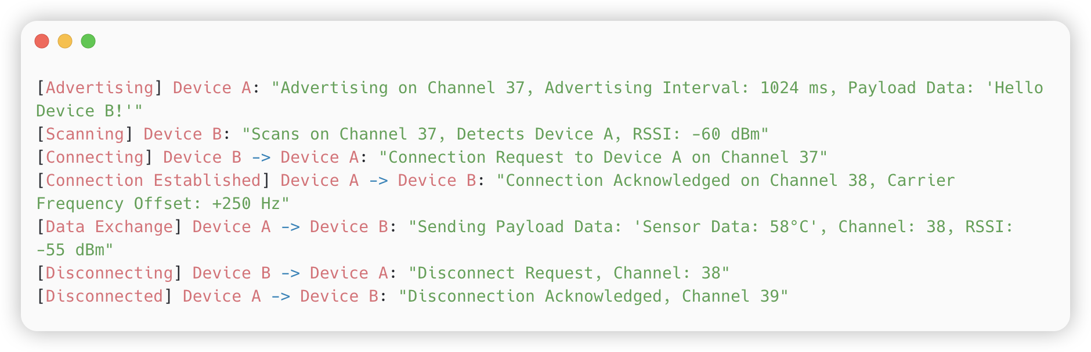
BLE Communication
BLE网络通信过程示例
BLE通信普遍缺乏Pairing验证环节
通过网络嗅探器(Sniffer)采集通信过程
相关文本用于深度学习的时序特征分析
Notes:
In this stage, to solve the noise interference problem, we used gaussian filter to pre-process the data and highlight the key data change of network cyber-features.

Slide 10
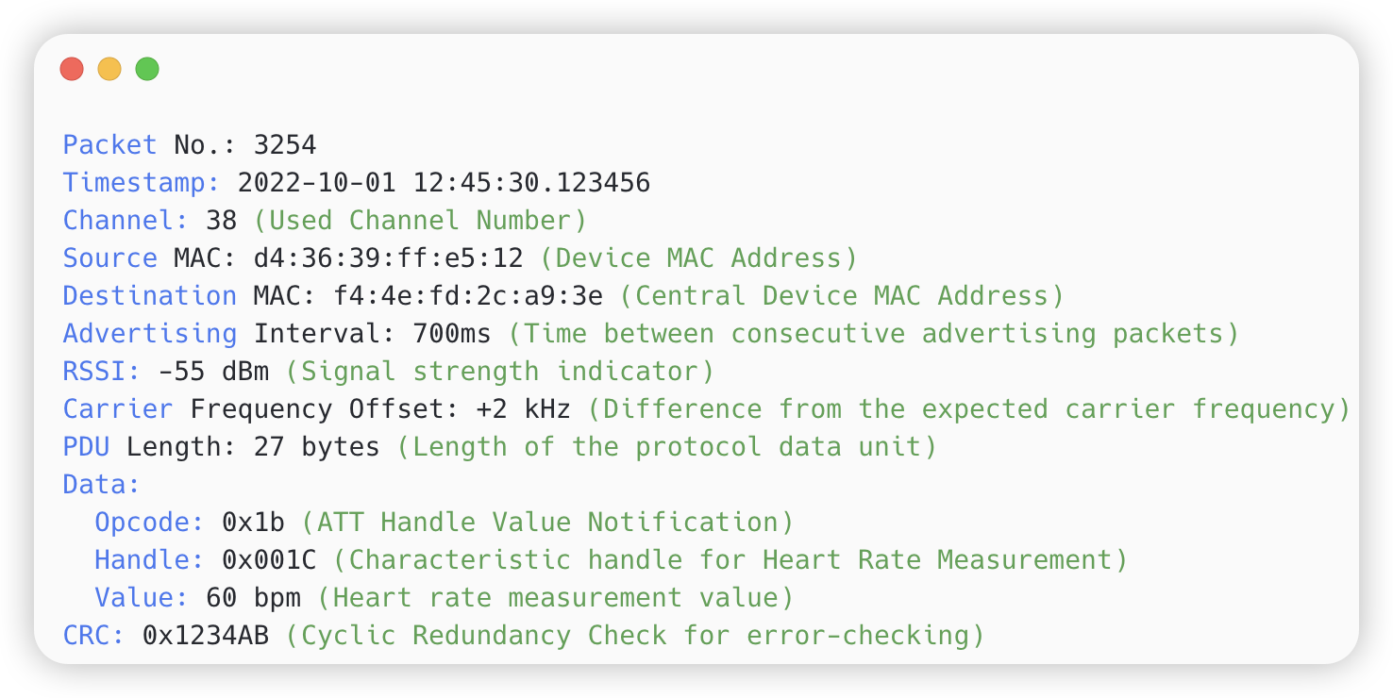
Cyber-physical Features
How to distinguish malicious data from the benign data?
时间序列数据分析
Packet Number
Timestamp 时间戳
Used Channel
Source MAC
Advertising Interval
RSSI data 信号强度
CFO data 频率偏差
Payload Data 负载数据
BLE网络数据包示例
Notes:
In this stage, to solve the noise interference problem, we used gaussian filter to pre-process the data and highlight the key data change of network cyber-features.

Slide 11
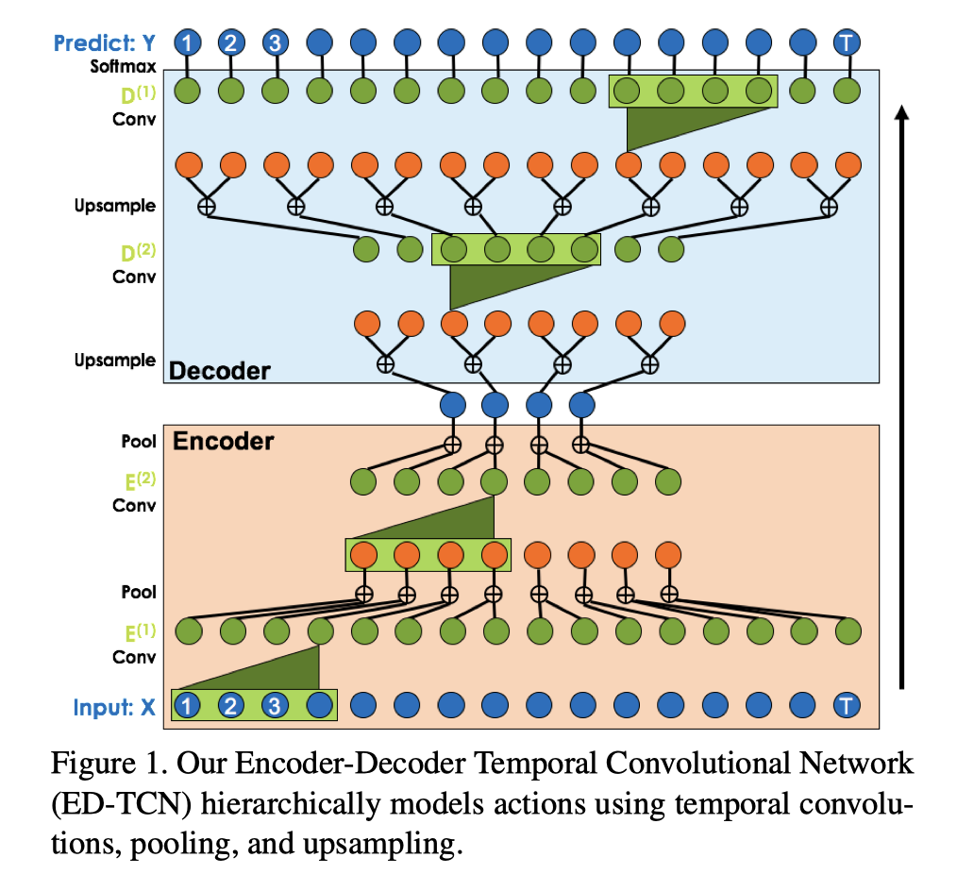
Temporal Convolutional Network (TCN)
时序卷积网络（ 编码器+解码器结构）
输入（Input）：序列数据的输入，图中用蓝色圆圈表示。每个圆圈代表序列中的一个时间点上的数据。
编码器（Encoder）：分负责提取输入数据的特征。通过一系列的卷积层（Conv）和池化层（Pool），编码器抓取并压缩了时间序列的信息，每经过一层，时间序列就被进一步抽象。
解码器（Decoder）：解码器的工作是将编码器的输出重新构建为具有更详细信息的输出序列。它通常包含上采样（Upsample）层和卷积层，上采样层将数据扩展到更高的维度，卷积层则进一步精细化这些数据。
预测（Predict）：最顶部是输出层。它通常包含一个Softmax层，用于将解码器的输出转换成最终的预测结果，如分类或者下一个时间点的数据。
Notes:
重点在于，ED-TCN可以捕捉时间序列数据中的复杂结构和模式，包括长距离的依赖关系。这使得它在诸如行为识别、时间序列预测等任务中非常有用。
编码器-解码器架构在于它的两个阶段工作方式：编码器压缩和提取信息，而解码器则基于这些信息进行重建或预测。这样的模型结构非常适合于序列到序列的任务，其中输出序列的长度可能与输入序列不同。

Slide 12

TCN model for BLE networks
Input
Output
Benign activities
Benign predictions
输入：来自BLE设备的一系列时间序列数据。一个特定时间点上的多维特征向量（序列）
可以包括RSSI值、所用的频道、当前时间步的数据包类型。这些数据是按照时间顺序收集的
输出：对应输入时间序列的每个时间步的预测结果
模型可能在每个时间步输出一个关于通信状态的分类（正常、可疑、异常），或者某个时间段内的信号强度
TCN Model
端到端模型
Notes:
In this stage, to solve the noise interference problem, we used gaussian filter to pre-process the data and highlight the key data change of network cyber-features.

Slide 13

TCN Learning: Input to Output
Input
Output
Benign activities
Benign predictions
Input
Output
Malicious activities
Malicious predictions
TCN Model
Notes:
In this stage, to solve the noise interference problem, we used gaussian filter to pre-process the data and highlight the key data change of network cyber-features.

Slide 14
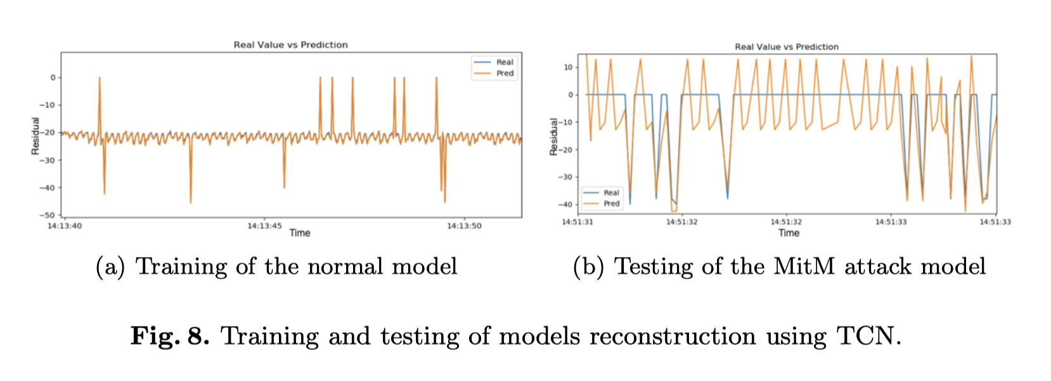
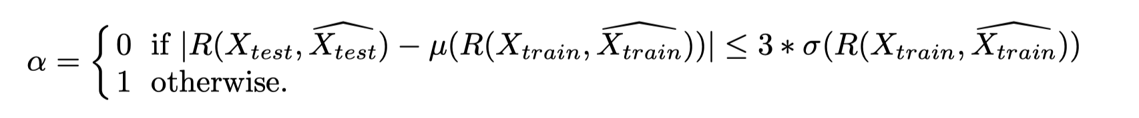
Training and Testing of TCN model
Notes:
In this stage, to solve the noise interference problem, we used gaussian filter to pre-process the data and highlight the key data change of network cyber-features.

Slide 15
Anomaly Detection (TCN)
Key formula for anomaly detection (Anomaly Score: $α$)
Notes:
In this stage, to solve the noise interference problem, we used gaussian filter to pre-process the data and highlight the key data change of network cyber-features.

Slide 16
Testing Simulation & Real Attack Scenario
Notes:
In this stage, to solve the noise interference problem, we used gaussian filter to pre-process the data and highlight the key data change of network cyber-features.

Slide 17
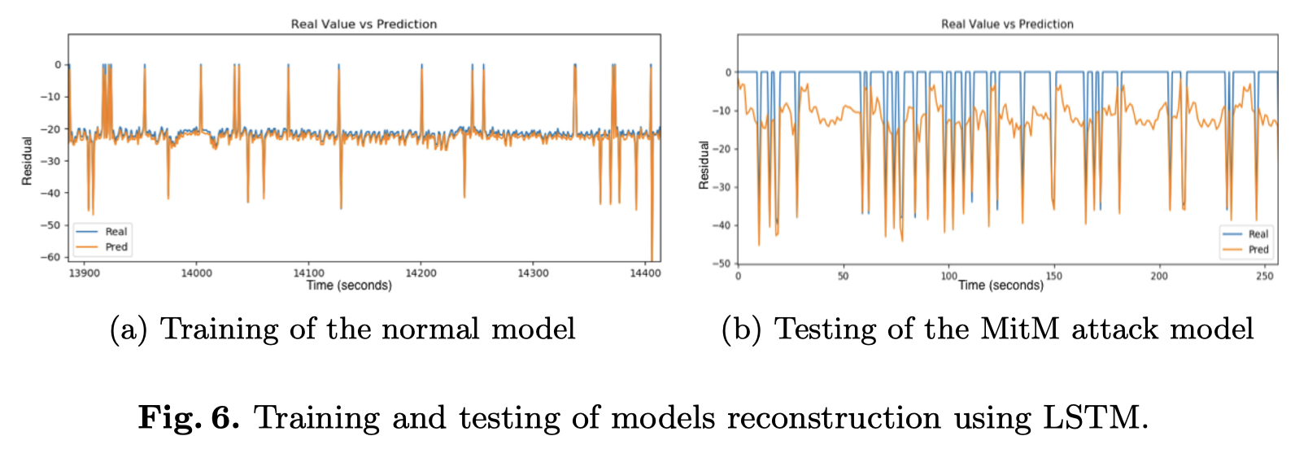
TCN model & LSTM model
TCN模型的优势
可以有效捕捉长期的时间依赖性
在较少的样本情况下获得更好的结果
在预测攻击流量行为时更为准
重构误差更低，并且具有更强的 记忆效果
易于并行处理，训练速度快
Notes:
In this stage, to solve the noise interference problem, we used gaussian filter to pre-process the data and highlight the key data change of network cyber-features.

Slide 18
TCN model in the Hybrid Structure
TCN Model
只能在批量级别检测异常，而不能精确到单个数据包的检测
Notes:
In this stage, to solve the noise interference problem, we used gaussian filter to pre-process the data and highlight the key data change of network cyber-features.

Slide 19
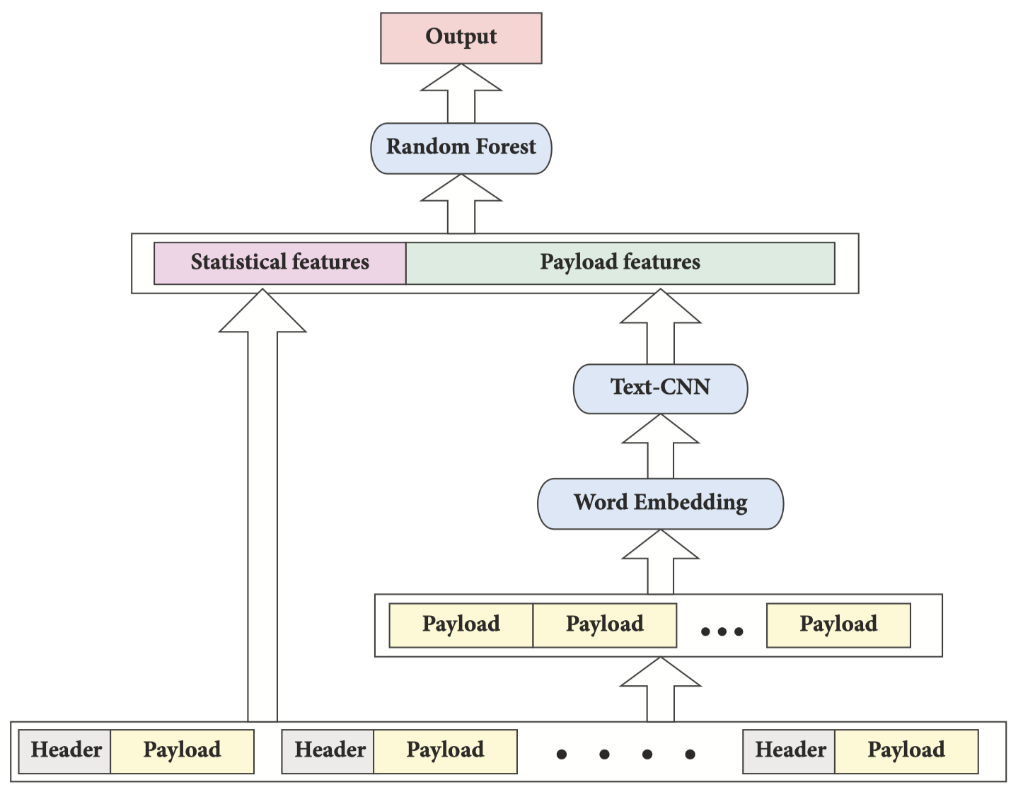
Detection & Classification
text-CNN + Classifiers
精确到单个异常BLE数据包的检测，为系统提供动态反馈
Notes:
In this stage, to solve the noise interference problem, we used gaussian filter to pre-process the data and highlight the key data change of network cyber-features.

Slide 20
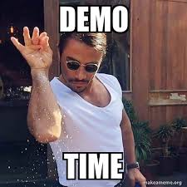


Demo Time!
Notes:
In this stage, to solve the noise interference problem, we used gaussian filter to pre-process the data and highlight the key data change of network cyber-features.

Slide 21



回顾与建议
本科生，如何把毕设发表到领域权威期刊 / 会议？
选择大于努力：实验 > 理论，迁移应用 > 架构更新 （注意语境！）
故事感：有意义的研究，佐以丰富的应用前景 + 清晰的论文写作
工作量：“三个臭皮匠，顶个诸葛亮”，用诚意打动审稿人
努力，还是努力：历经多次拒稿，终于抵达“最佳目的地”
Notes:
As the most widely used low-power communication protocol, cybersecurity research on Bluetooth Low Energy (BLE) has gained great attention. However, due to the security limitations, spoofing attacks can easily compromise BLE devices.

Slide 22
Thank you for your Listening!
Our Related Paper
[1] Hanlin Cai, Tozammel Hossain, Zhezhuang Xu*. “Securing Billion Bluetooth Devices leveraging Learning-based Technique”. The 38th Annual AAAI Conference on Artificial Intelligence. Undergraduate Consortium (AAAI 24, Research Proposal)
[2] Hanlin Cai, Yuchen Fang, Meng Yuan, Tozammel Hossain, Zhezhuang Xu*. “BLEGuard: Hybrid Detection Mechanism for Spoofing Attacks in Bluetooth Low Energy Networks”. Expect to submit to the 29th ACM SIGKDD Conference on Knowledge Discovery and Data Mining (Preprint)
Our data and model can be found here: https://github.com/BLEGuard/supplement
Presenter: Hanlin Cai
April 2024
Notes:
So, that’s all of my presentation. Here is our related works and open-source data. Thank you for your listening!

Slide 23
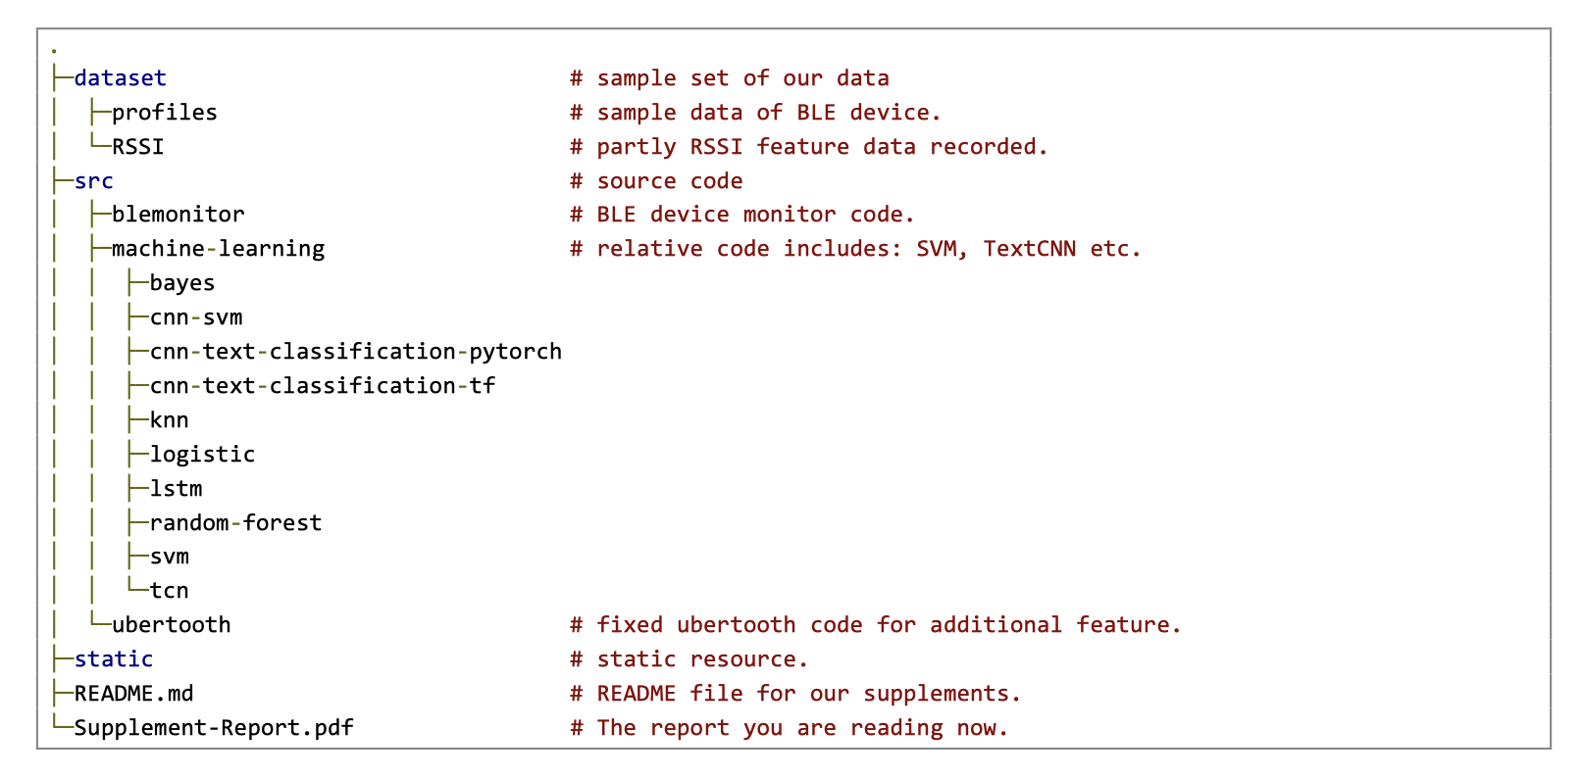
Supplements
Our data and model can be found here: https://github.com/BLEGuard/supplement
Notes:
So, that’s all of my presentation. Here is our related works and open-source data. Thank you for your listening!

Slide 24
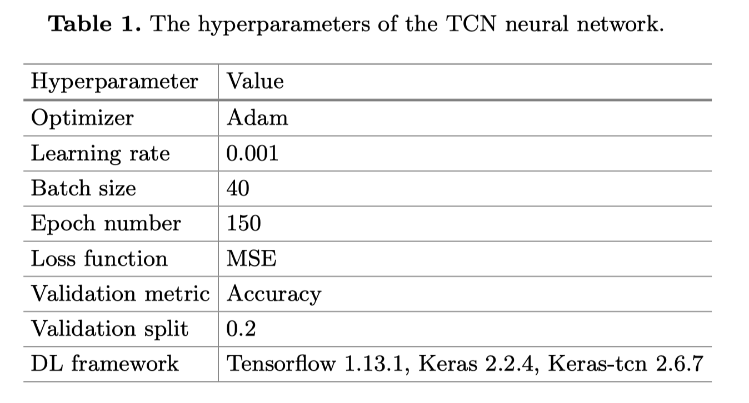
Appendix 1
较小的卷积核：通常可以捕获短期的依赖关系。它允许模型关注输入数据中的精细模式和快速变化。对于快速变化的时间序列或在短时间尺度上需要检测异常的场景，较小的卷积核可能更合适。
较大的卷积核：可以捕获更长期的依赖关系。这对于包含长期趋势或模式的时间序列尤其重要，例如在异常检测中，异常行为可能在较长的时间跨度内逐渐表现出来。
Notes:
So, that’s all of my presentation. Here is our related works and open-source data. Thank you for your listening!

Slide 25
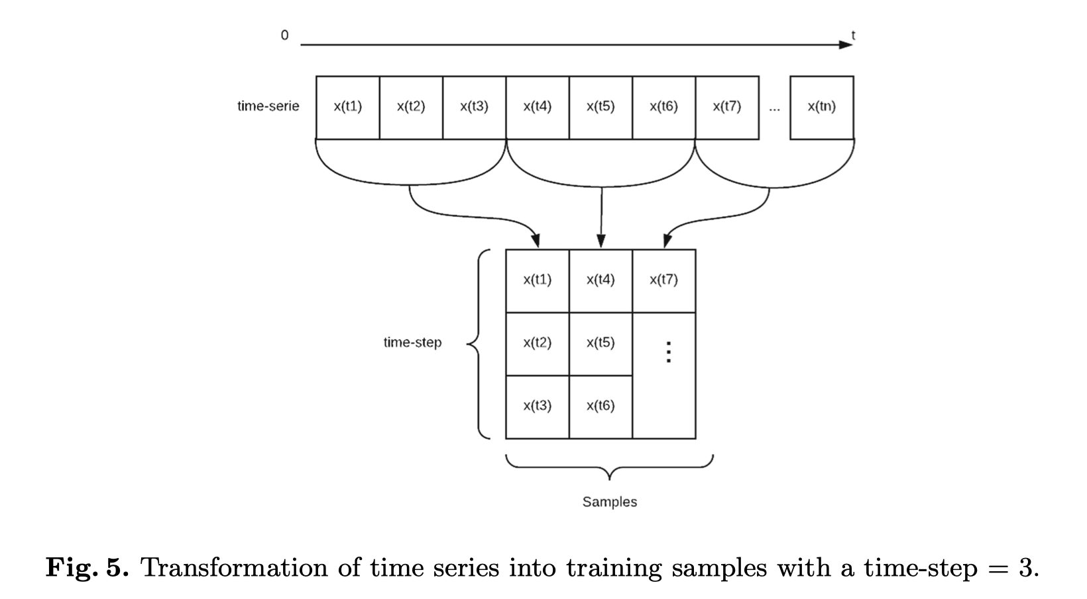
Appendix 2
Notes:
So, that’s all of my presentation. Here is our related works and open-source data. Thank you for your listening!

Slide 26
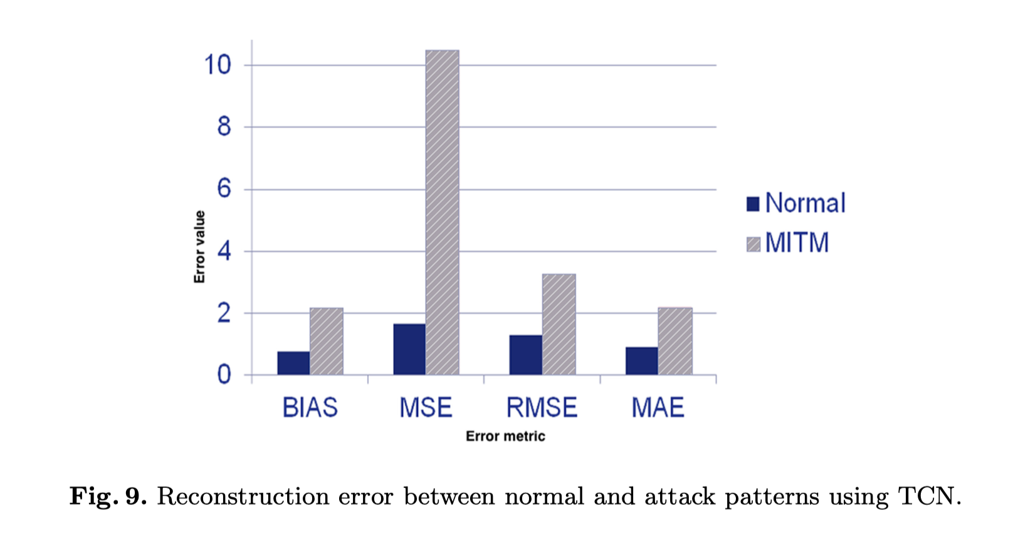
Appendix 3
Notes:
So, that’s all of my presentation. Here is our related works and open-source data. Thank you for your listening!

Slide 27
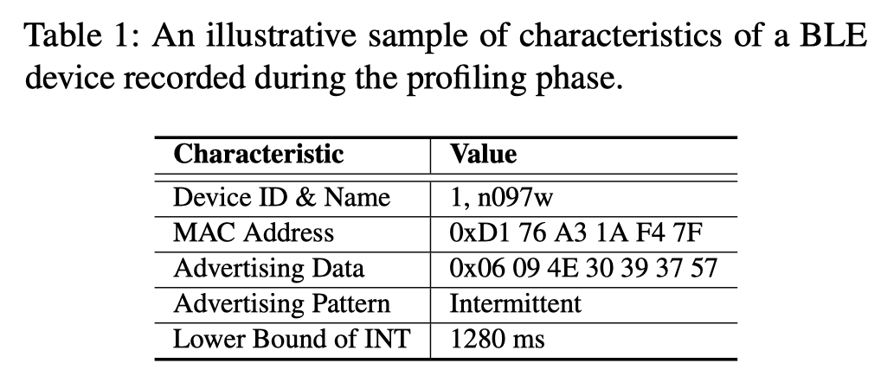
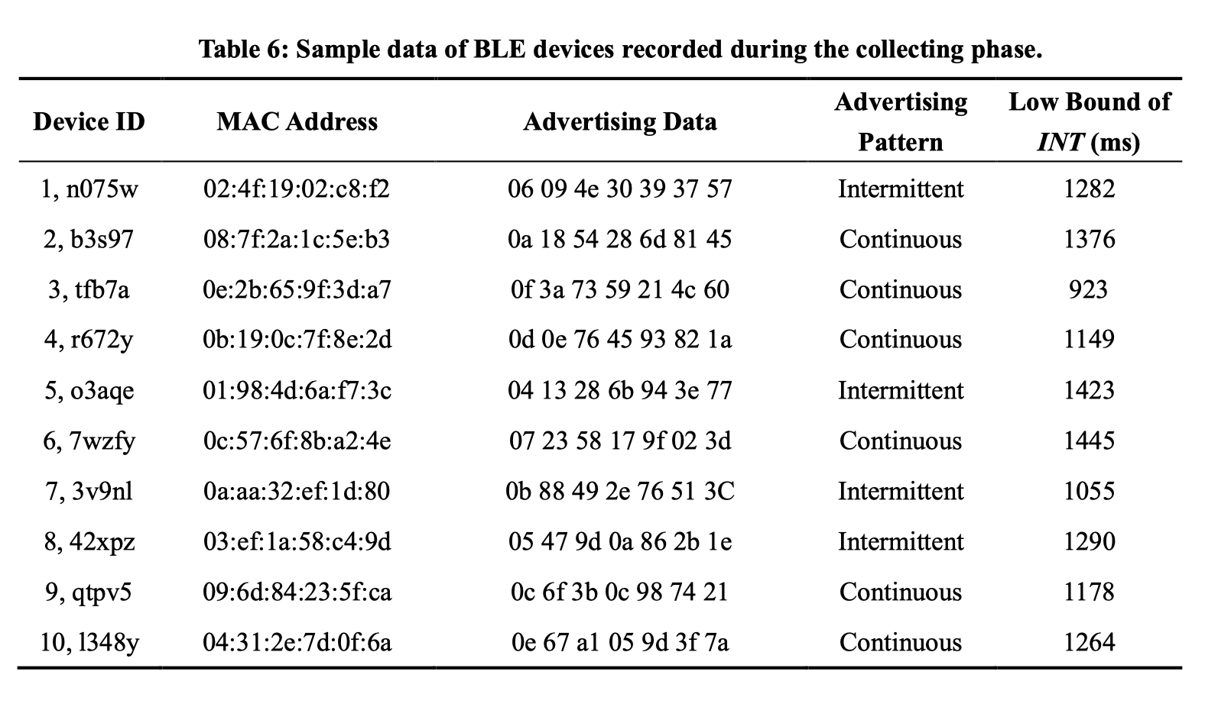
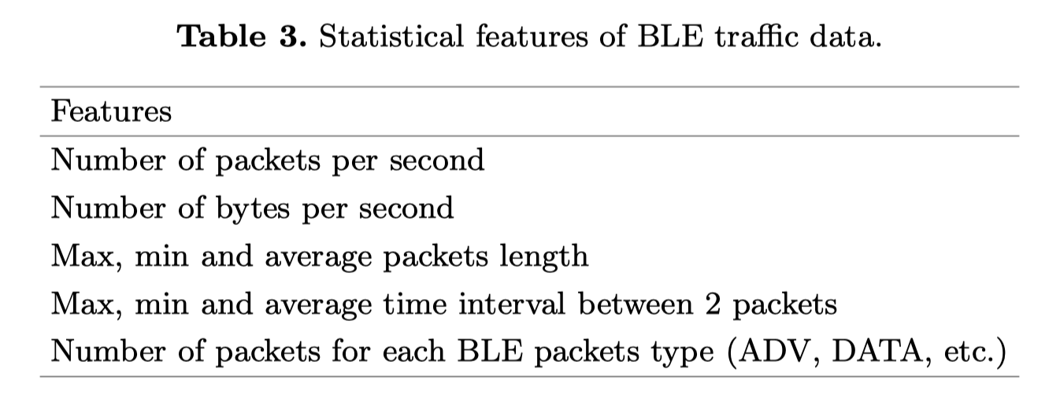
Appendix 4
Notes:
So, that’s all of my presentation. Here is our related works and open-source data. Thank you for your listening!

Slide 28
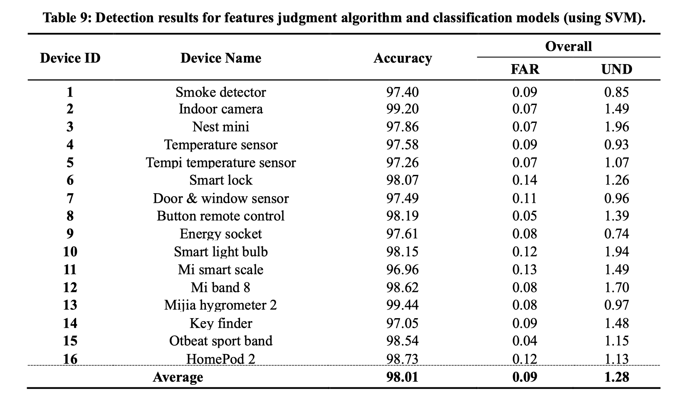
Appendix 5
Notes:
So, that’s all of my presentation. Here is our related works and open-source data. Thank you for your listening!

